Slide 1
Moving from Discipline to Guidance
Dan Gartrell Fall 2023

Slide 2
Background: Former Head Start Teacher
First year, taught 6th grade in a city school in Ohio…where the principal issued paddles for discipline! Didn’t take one, but what an introduction to the profession that year was!
Next year, taught Head Start for the Red Lake Ojibwe in Minnesota. They really loved those kids there. Wonderful experience.
Interest in guidance from those two night & day first teaching gigs.
Became a CDA trainer and advisor. Got my MS and Ed.D. Was director of Child Development Training Program and prof. of ECE at Bemidji State University, MN for almost 40 years.
Written 7 books and a long-running column on guidance.
Member of two families that include wife Dr. Julie, 5 kids, 15 grandkids and 2 great-grandkids!
Retired, I am into photography, writing & speaking, and yard work!
Notes:
PHOTOS

Slide 3

Scene you might see in Minnesota.
(But not in the winter!)
Notes:
Outdoor photography is a hobby of mine. This is a lake in Minnesota where my wife and I are from.

Slide 4
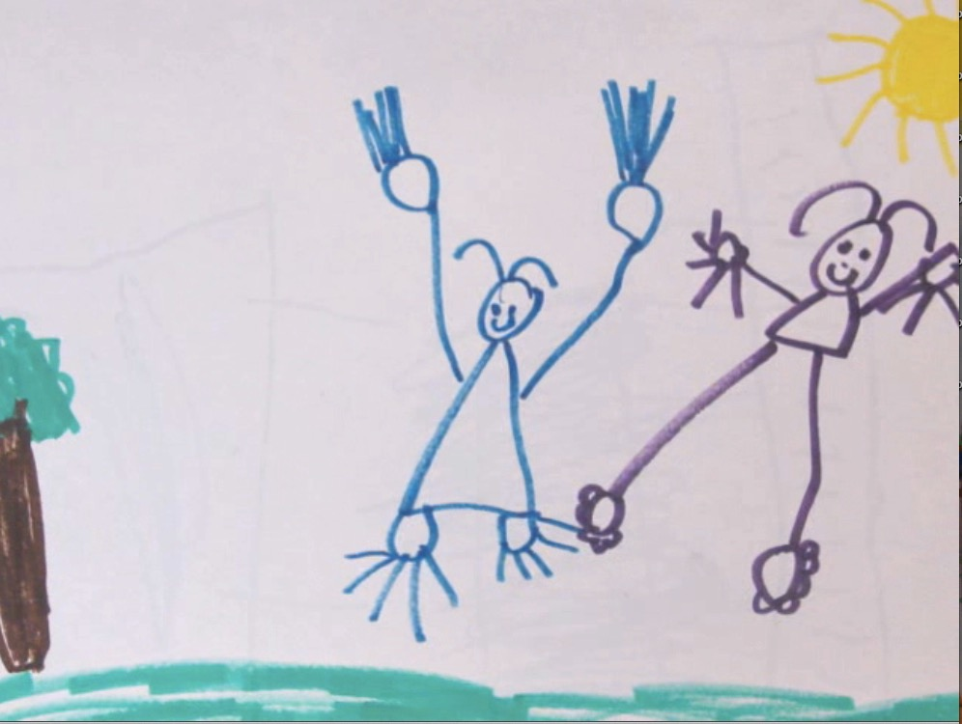
.
Presentation Notes:
•My PPTs are quirky, wordy, and semi-wise.
•To our mutual relief, I won't lecture point-by-point but will discuss what I think are key points.
•For many slides, I will remain silent for a bit so you can read the material
•For your discussion of a point, refer to slide #, bottom right of slide.
•References for the PPT are in a book and articles given at the end.
•A chemistry experiment (picture) by a preschooler like this one means a change of topic.
Notes:
Watch for preschoolers pictures. They separate sections of the presentation. HEAD SHOT.

Slide 5
Introduction
Slide One:
Moving away from Conventional Discipline
Young children are best thought of as months-old, not years old. Their brain development is amazing, but just beginning, and they have limited life experience. They are just starting to learn complicated life skills, and regularly make mistakes in their behavior. The result is disagreements with others: conflicts. Children should not be punished for making mistakes.
The problem with conventional discipline is that it too easily slides into punishment. Conventional discipline punishes young children for what they haven’t learned yet, and makes it harder for them to learn the very emotional-social skills we want them to learn.

Slide 6
Introduction
Slide Two: What Guidance Is
When conflicts happen, as they do every day with young children, guidance professionals are friendly leaders. Using trust-based relationships, they calm and teach. Guidance is teaching:
For children to learn from their mistakes and to manage their problems.
For healthy personal development, beginning with the emotional and encompassing all developmental domains.
For children to gain five Democratic Life skills so that they can be healthy adults and engaged citizens.
Teachers use 1) developmental guidance to build encouraging early learning communities for every child, and 2) Intervention guidance to sustain them.

Slide 7
Introduction
Slide Three:
The Purpose of Guidance
The purpose of guidance is to teach children to gain five Democratic Life Skills. Democratic Life Skills signify the child’s capacity to gain a sense of safety--security, belonging and self worth--and grow toward creative problem solving and pro-social behaviors. Adults at DLS 3,4,& 5 further democracy..
Safety-Needs Skills. (Work on in order.)
1) See one's self as a worthy member of the group and as a worthy individual.
Express strong emotions in non-hurting ways.
Growing-Needs Skills. (Work on together.)
3) Solve problems creatively--by one's self and in cooperation with others.
4) Accept differing human qualities in others.
Make decisions intelligently and ethically.
For an introduction to the Five Democratic Life Skills, see NAEYC/blog/The Road Forward …and Dan’s latest book. for many of the ideas in this session. Again, my
Notes:
Safety needs first and sequential. Growing needs skills second and happen together.

Slide 8
Introduction
Slide Four:
Three Levels of Mistaken Behavior
All humans experience conflicts. The eternal question is how we handle our conflicts. Months-old children experience many conflicts each day. Because they are just beginning to learn to manage their emotions, they show one of three levels of mistaken behavior.
Level 3. Strong unmet needs mistaken survival behavior. DLS 1&2. Due to high stress kids at Level 3 shown aggression or withdrawal to protect themselves. Deeply challenged kids show Level 3.
Level 2. Socially influenced mistaken behavior.DLS 2-3. Kids who look to others for security fall into level 2.
The significant others might be in or out of the setting.
Level 1. Experimentation level mistaken behavior. DLS 3,4,&5. Kids who are developing in healthy ways make independent choices that go wrong. The life experiments can be intentional or unintentional.
Guidance professionals work with children differently depending on which level is observed—but always working from and on a trust-based relationship with the child.
Notes:
Safety needs first and sequential. Growing needs skills second and happen together.

Slide 9
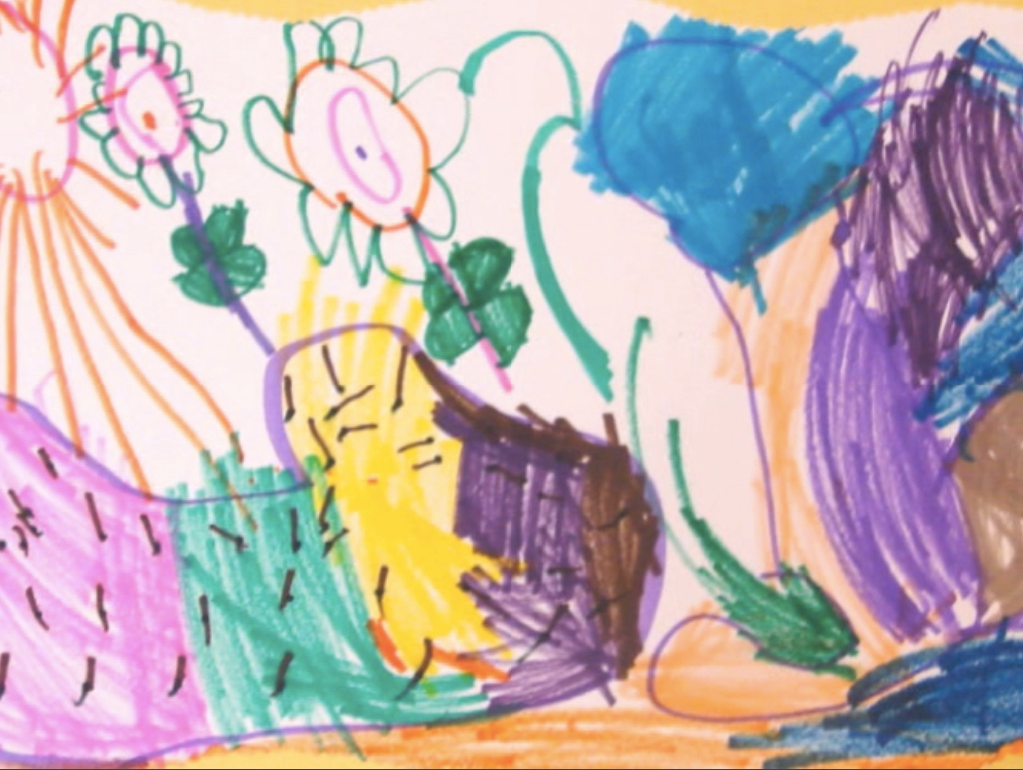
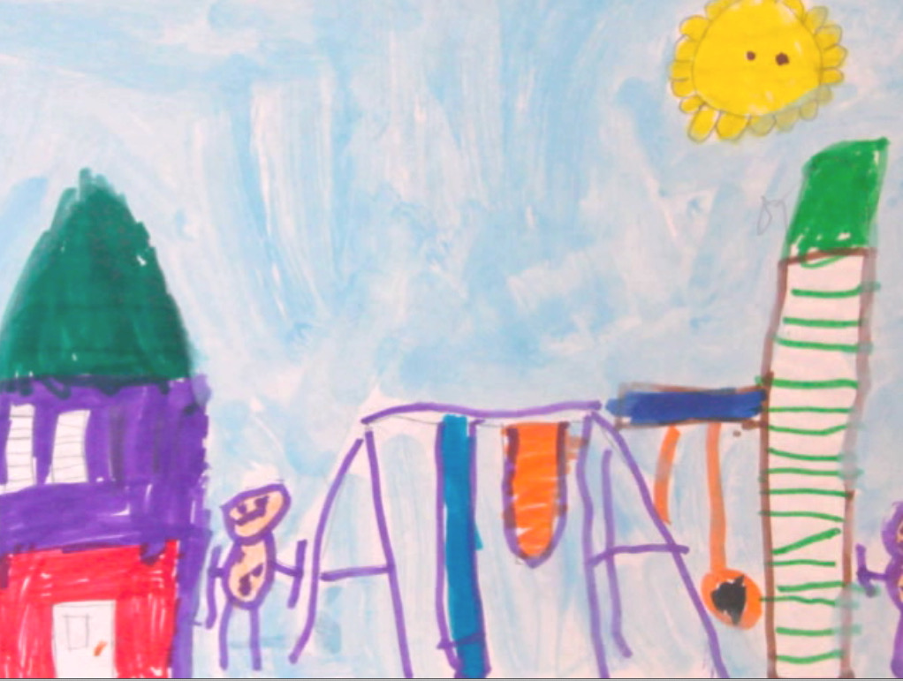
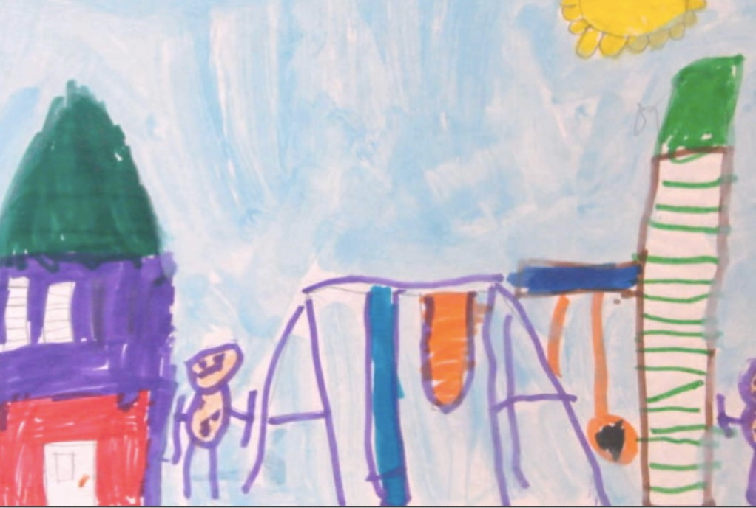

Slide 10
Topic One: Developmental Guidance
Five Developmental Guidance Understandings:
1. Whenever possible work as a Teaching Team. The TT:
2. Builds an Encouraging Early Learning Community
3. Creates and Maintains Secure Relationships
4. Practices Key Communication Strategies: Acknowledge and Pause and Contact Talks
5. Cultivates Teaching Team – Family Partnerships through Four Benchmarks for Family Engagement.

Slide 11
Developmental Guidance
Understanding One--
The Teaching Team
U-1. In an encouraging early learning community when adults work as a teaching team (TT), they can do together what individual staff have difficulty doing alone.
Children learn from all adults in a setting, not just the designated lead.
Consider it a team strength that some TT members relate more comfortably with some children and families than others. To build the community, do strategic pairing.
Friendly differentiated staffing shows children that adults from different walks of life can work together—so modeling democracy at work.

Slide 12
Developmental Guidance
Understanding Two—
Slide One:
Encouraging Communities
U-2. To use guidance well, EC professionals need programs to be developmentally appropriate for every child.
Programs are only DA when they are for every child, and not just children who are “typical” in appearance, learning patterns, and behavior.
We call developmentally appropriate settings for all encouraging early learning communities.
Encouraging communities begin in the minds of TT members.
Notes:
A priority in my view is for TTs to be intentionally inclusive of every child. The program is child-focused rather than program-focused.

Slide 13
Developmental Guidance
Understanding Two—
Slide Two:
Building with Developmental Guidance
TTs use Developmental Guidance to build encouraging early learning communities via:
1. Intentional relationship-building practices.
2. Inclusive, emergent, and active DA curriculum.
3. Regular group meetings.
4. Positive teacher-family relations.
The EC professional mediates between the curriculum, which is set out logically, and each child who learns psychologically. The child is more important than the curriculum.

Slide 14
Developmental Guidance
Understanding Three—
Building
Relationships
U-3. TTs build secure, trust-based, relationships with every child.
All young children need secure, trust-based relationships with significant others, parents and teachers, for then to feel safe and to grow and learn.
TTs build secure, trust-based relationships with every child in the community—not just most.
TT members can only build secure relationships with children outside of conflict situations.
Quality time of a TT member with each child, every day essential.

Slide 15
Developmental Guidance
Understanding Four--
Slide One:
To Build Relationships use
Acknowledge and Pause
U-4. Quality time of a TT member with each child, at least every day is essential. Acknowledge-and-pause and contact talks are gold and platinum practices for building relationships.
Use acknowledge and pause (A&P) to start conversations. A handy starter stem is “You are really…” and compliment a detail in what you see:
(1) “Using that chalk,”
(2) ”Riding that strider,”
(3) “Looking sad,”
Then pause for the child’s reply and respond supportively.

Slide 16
Developmental Guidance
Understanding Four—
Slide Two:
To Build Relationships
Rely on
Contact Talks
Contact talks are quality times that a TT member chooses to spent with a child. Their purpose is to get to know the child better and vice-versa.
Contact talks often flow from A&P:
(1) Chalk drawing: ”This is a bizzard and my Mom’s plowing, but you can’t see her.”
(2) Riding Strider: ”Yeah, I ride with my sister. She rides fast”
(3) Dog tragedy: ”My dog Bumpers got hit by a Car. He died.”
You then supportively extend the conversation. Contact talks are not task-oriented. They are often brief, but—at a minimum– they need to happen with every child, every day. All TT members can start and hold contact talks.

Slide 17
Developmental Guidance
Understanding Five—
Slide One:
Cultivate
TT-Family Partnerships
U-5. Positive TT-family partnerships are central to
the successful use of guidance, and TTs build the relationships from Day One.
TTs work hard to engage families in working cooperatively with programs. Families are the main teachers of their children; TTs only help. But, TTs can be a big help and make a lasting difference in children's lives. Be friendly first.
Being positive about the child puts you on the same side as the family.

Slide 18
Developmental Guidance
Understanding Five—
Slide Two:
Four Benchmarks for Family Engagement
Four Staff Benchmarks for Family Engagement. Family members:
Show acceptance of program and staff.
Take new interest in the learning of their child.
Become active in relation to the general program.
Progress in personal and/or professional development themselves as a result of their engagement.
All programs should work for family members to reach Benchmark 2. Many programs also work for members to reach 3 and sometimes 4.

Slide 19
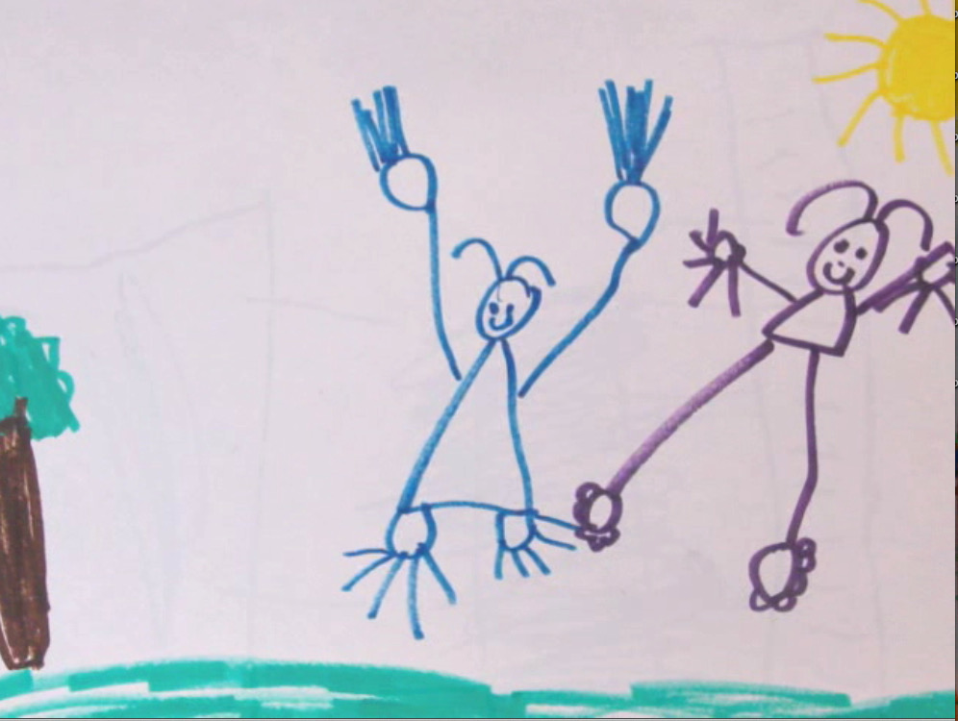
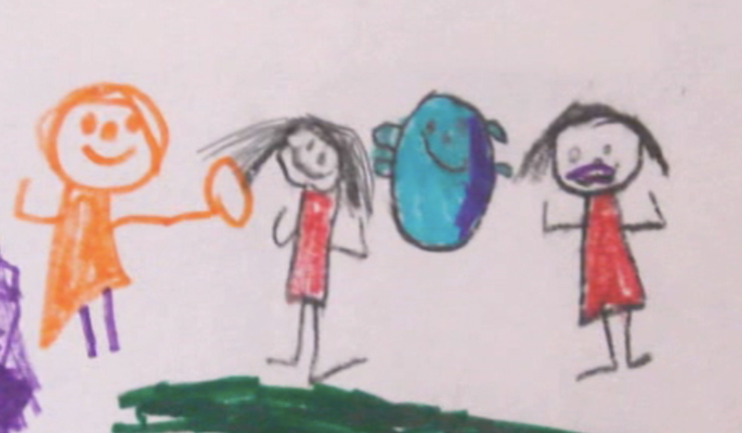

Slide 20
Topic Two: Intervention Guidance
Seven Intervention Guidance Understandings:
6. Challenged Children Show Challenging Behavior
7. Prevent the Stress-Conflict-Punishment Syndrome
8. Use the Five-Finger Formula for Social Problem Solving
9. Calm and Teach
10. Practice Guidance Talks, Conflict Mediation, and Large Group Meetings
11. Initiate Comprehensive Guidance
12. Aspire to Liberation Teaching

Slide 21
Intervention Guidance
Understanding Six—
Challenged Children Show Challenging Behavior
U-6. Challenging behaviors are shown by challenged children.
When young children have adverse experiences, they cannot manage their resulting high stress. They seek to protect themselves and relieve the stress by showing mistaken survival behaviors.
TTs think of a survival behavior, like aggression, not as “misbehavior” but as mistaken behavior. These kids need guidance not punishment.

Slide 22
Intervention Guidance
Understanding Seven—
Preventing the Stress-Conflict-
Punishment Syndrome
U-7. During conflicts, TTs do their best to sustain the trust-relationship, and to repair and improve the relationship afterwards. TTs work to liberate children from a possible Stress-Conflict-Punishment Syndrome:
Children have adverse experiences, ranging from “mild” (in adults’ thinking) to totally traumatic. They feel unmanageable stress.
Children show the mistaken survival behaviors of psychologically fleeing, freezing--acting out through aggression to relieve the stress.
Adults who misinterpret resulting conflicts as “misbehavior,” ”discipline” (punish) the child.
School-caused adverse experience make the child continue to feel unmanageable stress, and this cycle too easily repeats itself in the stress-conflict-punishment syndrome.

Slide 23
Intervention Guidance
Understanding Eight—
Five Finger Formula
U-8. During conflicts, TTs can use a general social problem-solving model such as the Five Finger Formula.
Thumb: Calm everyone down—yourself, too. Set the scene for the mediation.
Pointer: Guide the children to understand how each person sees the conflict. This step is key. All need to feel they have been heard.
Tall guy: Brainstorm possible solutions. Provide suggestions for children having limited language. Respect nonverbal communication from all.
Ringer: Agree to one solution and try it. Sometimes steps 3 and 4 naturally merge; this is fine.
Pinky: Monitor solution-activity and positively acknowledge pro-social efforts. Hold follow-up guidance talks with individuals as needed. Discuss what children can do next time instead.

Slide 24
An Illustration of the FFF Using Child Mediation (when the FFF is used more formally)
The conflict. Kayla likes to shoot hoops with a favorite ball, but today Shogi (like Yogi) has it. Kayla approaches Shogi with another ball, but the smaller boy won’t trade. Frustrated, Kayla knocks the “ball for big kids” out of Shogi’s hands. She grabs it and starts to shoot hoops. Shogi sits and yowls.
Step 1. Teacher Kiko calms Shogi and looks at Kayla, who comes over holding the ball and says, “Shogi wouldn’t trade.” Kiko says, "I think we have a problem here. “Let’s sit down, get cool, and work this out.” Kayla and Shogi both know Kiko is going to mediate. They sit down. Shogi follows Kiko’s lead and takes breaths. Kayla watches & waits.
Step 2. As Shogi shares, Kiko guides Kayla not to interrupt. Then Kiko gives Kayla a turn to share. Kiko repeats each child’s account, and the children nod that Kiko has it right.
Step 3. Kiko then says, “How can we fix this problem?” Realizing that she is not going to be punished, Kayla becomes less defensive. “Maybe Shogi could have a short turn, and then it is my turn.” Shogi nods that this will work.
Step 4. Having established his "playground creds," Shogi soon gives the ball to Kayla.
Step 5. Kiko has an individual guidance talk with Kayla and asks her to think of and share a better response for “next time.” Kiko thanks Shogi.

Slide 25
Intervention Guidance
Understanding Nine—
Slide One:
Calm and Teach
U-9. When conflicts happen, four practices are key to intervention guidance: 1) Calm all first; 2) Use guidance talks with individual children; 3) Use conflict management with a small number. 4) Use group meetings when conflicts go public.
1) Calm all first
•While upset, no one can resolve a conflict, especially children, but this includes you too.
• Suggest (perhaps model) a technique like taking deep breaths, or use reflective listening.
• If kids need time, give it to them, there or in another space.
•Remember: A “time-out” is a consequence for something a child has done. A cooling down time is moving a child to another space to help them calm down so all can fix the problem.

Slide 26
Intervention Guidance
Understanding Nine—
Slide Two:
Guidance Talks
2) Use guidance talks when individual children have conflicts.
•Guidance talks are not “talking to” but talking with the child.
• TTs use the FFF, but informally, and begin with the first step, calming.
• Guide the child to say their side of what happened. Accept the child’s version as to how they saw it.
• Non-judgmentally, help the child understand the consequences of the conflict.
•Ask the child how they can make things better. (Don’t force the child to say “I'm sorry.”)
•Talk with the child about what they can do next time instead. Sensitively follow-up.

Slide 27
Intervention Guidance
Understanding Nine—
Slide Three:
Conflict Mediation
3) Use conflict management when a small number are involved in a conflict. Here, TTs use the Five Finger Formula formally:
Thumb: Calm everyone down—yourself, too. Set the scene for the mediation.
Pointer: Guide the children to understand how each person sees the conflict. This step is key. All need to feel they have been heard.
Tall guy: Brainstorm possible solutions. Provide suggestions for children having limited language. Respect nonverbal communication from all.
Ringer: Agree to one solution and try it. Sometimes steps 3 and 4 naturally merge; this is fine.
Pinky: Monitor solution-activity and positively acknowledge cooperative efforts. Hold guidance talks with individuals as needed. Discuss what children can do next time instead.

Slide 28
Intervention Guidance
Understanding Nine—
Slide Four:
Large Group Meetings
4) Large group meetings. The meetings are used in both developmental and intervention guidance. In both, TTs use the FFF informally.
•Developmental guidance meetings set up a few community guidelines, like “Be friendly to our mates.” (Children decide on their own friends.)
•D.G. meetings also set up group-meeting guide- lines like “listen carefully” and “Don’t say names.”
• I.G. meetings resolve problems that have gone public, like kids calling each other “butthead.”
•TTs guide the meetings so they model mutual respect, solve problems, and build group spirit.
•Group meetings are a guidance improvement on group punishments.
•Group meetings directly teach children for living in a democracy.

Slide 29
An Illustration of an Intervention Large Group Meeting with Preschoolers
In their regular morning meeting preschool Teachers Carla and Dyson introduce a four-sided climber they put up in the active play area. They discuss with the children when it will be open, how many can be on it, and what being safe on the climber means. On the second day, one child has fingers stepped on while climbing the ladder. Another child gets jostled on the top platform. A 3rd child going down the slide bumps into a 4th child climbing up the slide.
On this afternoon the teaching team calls an unscheduled group meeting. Carla explains there have been some problems on the climber. She asks children to share. Without naming names, the four do. Loosely following the 5-finger formula, the TT asks the children how we can make sure the
climber is safe for all. The children come up with ideas and Dyson interprets and records them on a big chart: “Watch out when kids are climbing up.” “No standing and give kids room for kids on top.” “We go down the slide except for Fridays.” Carla and Dyson especially liked the last idea. It gave the group a chance for upper body exercise and was a functional calendar lesson.
The group reviewed the guidelines at the next morning’s meeting and Carla posted them by the climber. The guidelines worked. Dyson later commented that when he was in school, the teachers would have just taken the climber down—a traditional “group punishment” that would have undermined group spirit and the children’s faith (trust) in the teacher.

Slide 30
Intervention Guidance
Understanding Ten—
Comprehensive Guidance
U.10. When children have severe conflicts, the TT uses comprehensive guidance that includes staff and parents.
One teacher leads a team effort. Meets with TT and other staff to discuss problem.
TT Holds meeting with family using compliment sandwich approach and inviting input.
Together, complete Individual Guidance Plan (Download from dangartrell.net).
Lead oversees IGP implementation. Holds follow-up meeting if needed.
TT never gives up on the child. Only after comprehensive guidance would TTs help family find another program with needed resources for the child and family.
More: Download "Comprehensive Guidance," under Guidance Matters Columns, dangartrell.net

Slide 31
Intervention Guidance
Understanding Eleven—
Liberation Teaching
U-11. TTs practice liberation teaching. They save children from the long-term dangers of the Stress-Conflict-Punishment syndrome.
TTs use liberation teaching with children who show a pattern of strong unmet needs mistaken behavior.
A main strategy of liberating teachers is informal or formal Comprehensive Guidance.
Liberation teaching works to prevent the pattern in the US of pushing too many young children out the door--& into the Stress-Conflict-Punishment Syndrome.
Liberation teaching builds children's resilience through guiding them to gain DLS 1 and 2.
Through buffering, supporting, nudging, & leading, liberation teaching means never giving up on any child.

Slide 32
Summary:
The Five Democratic
Life Skills
The Purpose of Guidance
As children gain the Safety-Needs Skills,
1) See one's self as a worthy member of the group and as a worthy individual.
Express strong emotions in non-hurting ways.
they feel empowered to gain the Growing Need Skills
3) Solve problems creatively--by one's self and in cooperation with others.
4) Accept differing human qualities in others.
Make decisions intelligently and ethically.
For an introduction to the Five Democratic Life Skills, see NAEYC/blog/The Road Forward …and Dan’s latest book, info at end of powerpoint.of the ideas in this session. Again, my
Notes:
Safety needs first and sequential. Growing needs skills second and happen together.

Slide 33
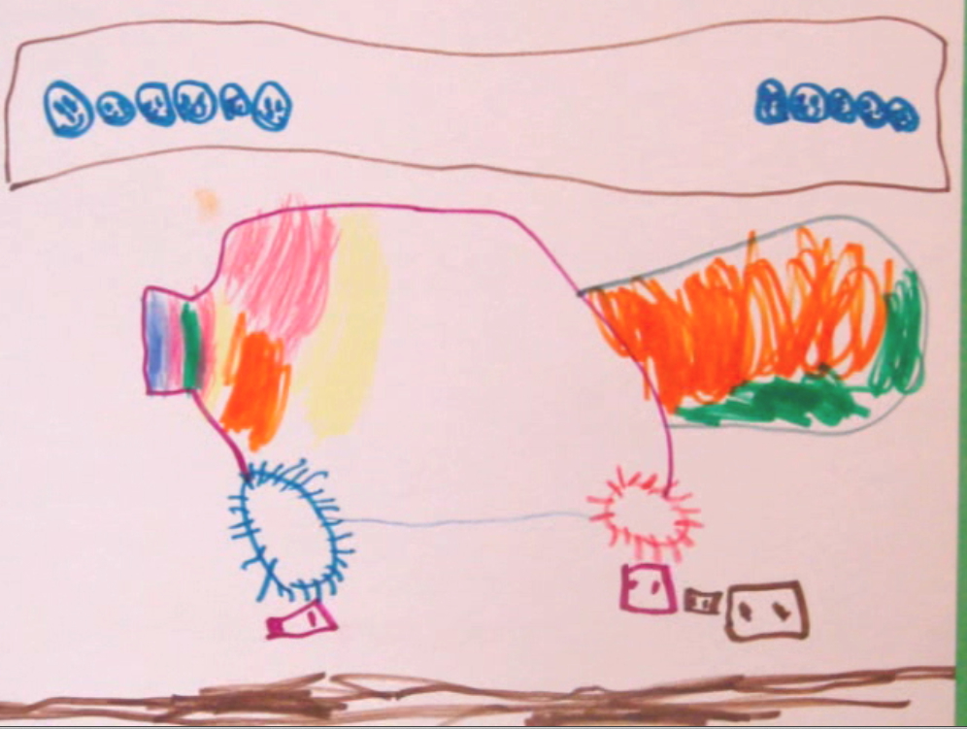

Slide 34
Topic Three: Guidance Wrap-up
Understanding Twelve—
Take Care of You!
U-12. In order to work from DLS 3, 4, and 5 themselves, early childhood professionals need adequate financial and personal resources.
•Most EC professionals subsidize the cost of their programs by taking low salaries. They are subject to the social stressors of marginal livable wages.
•Early childhood programs need and deserve more government funding, along with agencies that support and ensure high quality programming.
•To be at their best, EC professionals need support systems both on the job and in their personal lives.
•To reach out for personal support is a sign of strength.
•Not technicians but professionals, TT members learn even as they teach.
•A friendly sense of humor is a rejuvenating teaching quality for all.

Slide 35
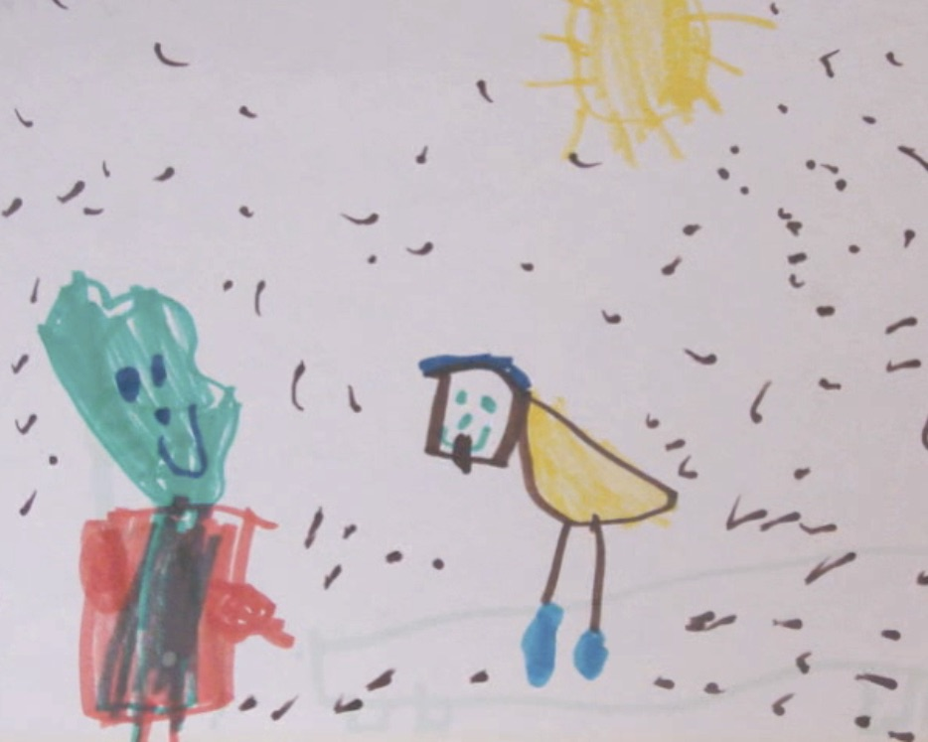
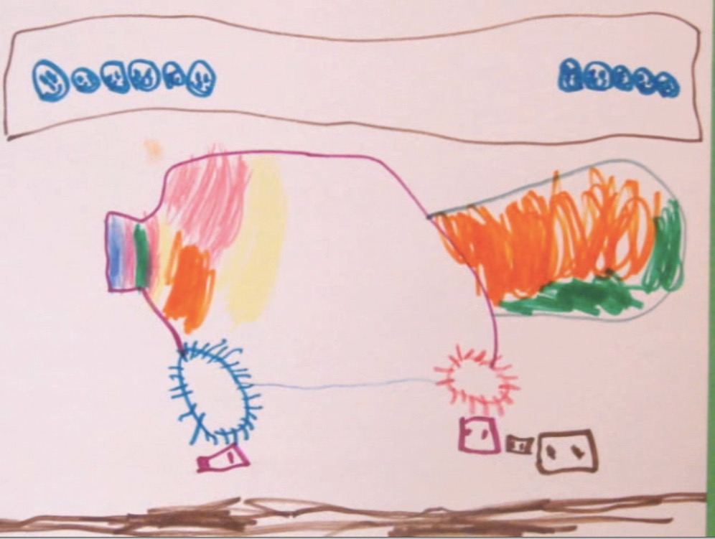
Thank you for participating in this session.
Aloha.
dangartrell.net
gartrell@paulbunyan.net
Notes:
BOOKS.

Slide 36
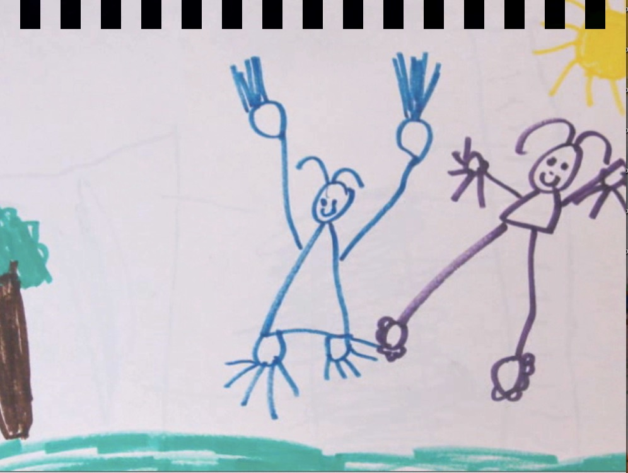
Handouts related to PPT
(Free downloads at Dan's Website)
•Instead of Discipline, Use Guidance
•Twelve Guidance Understandings
References for the PPT
•The Road Forward: Teaching for 5 DLS https://www.naeyc.org/
resources/blog/democratic-life-skills
•Dan's latest book on next page.
Notes:
BOOKS.

Slide 38
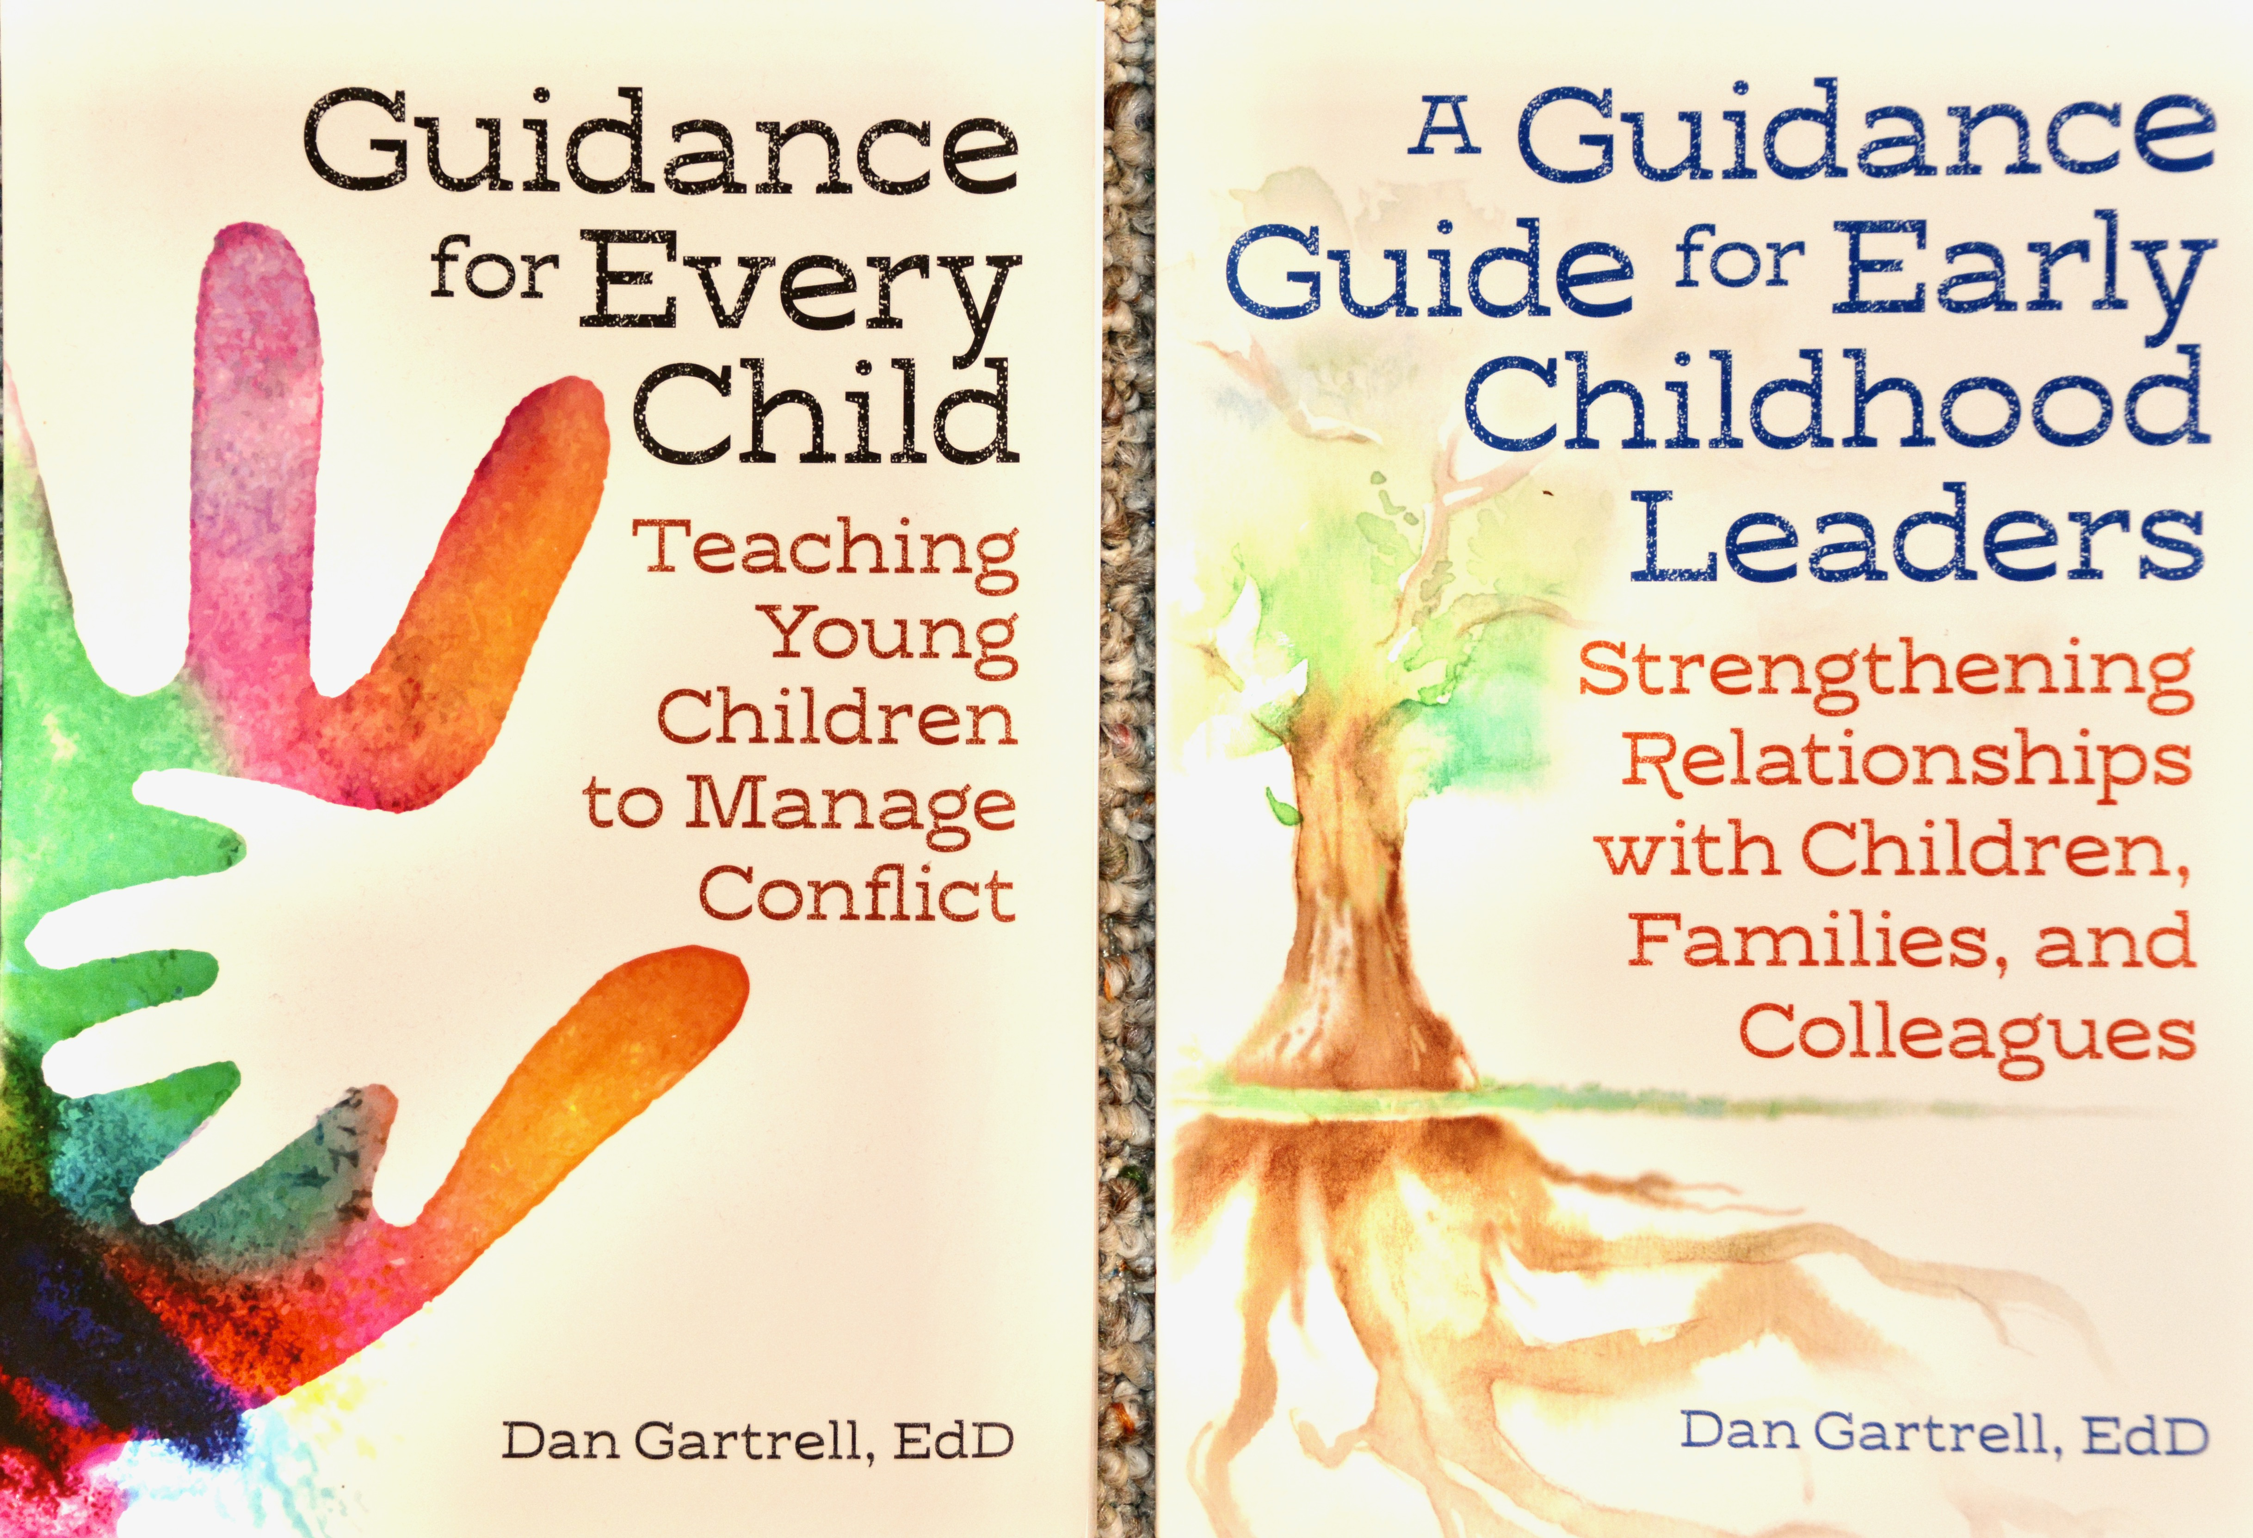
Dan’s two Redleaf Press books (2016; 2020).
Guidance for Every Child is an informal textbook for students going into the field.
A Guidance Guide is for new and experienced early childhood professionals to help them become the leaders they would like to be.

